Slide 1
GEOG0113 Lecture 003 The Terrestrial Carbon Cycle
P. Lewis
UCL Geography
& NERC NCEO

Slide 2
Aims of lecture
In this lecture, we will:
looked in detail at the terrestrial carbon cycle
provide an overview of relevant biogeochemical processes

Slide 3
Terrestrial Carbon
carbon that is stored in the vegetation and soils of the Earth’s land surface
The Earth Systems Science:
Maintain focus on interactions between different spheres, but understand processes and interactions within each sphere.

Slide 4
Terrestrial Carbon
Justification:
major role it plays in anthropogenic climate change.
Also:
the role that terrestrial vegetation plays in biodiversity;
role of vegetation in providing food and fuel.

Slide 5
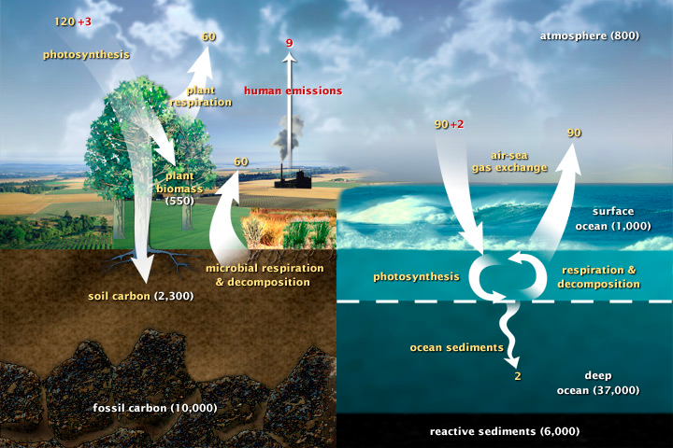
The Carbon Cycle
Notes:
This diagram of the fast carbon cycle shows the movement of carbon between land, atmosphere, and oceans. Yellow numbers are natural fluxes, and red are human contributions in gigatons of carbon per year. White numbers indicate stored carbon

Slide 6
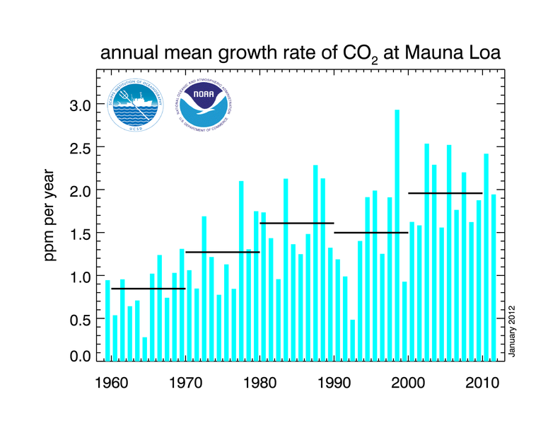
CO2 growth rate
Notes:
The annual mean growth rate of CO2 in the atmosphere is around 2 ppmv of CO2, from which it can be inferred that just over 2 ppmv of CO2 must enter other fast pools of carbon.

Slide 7
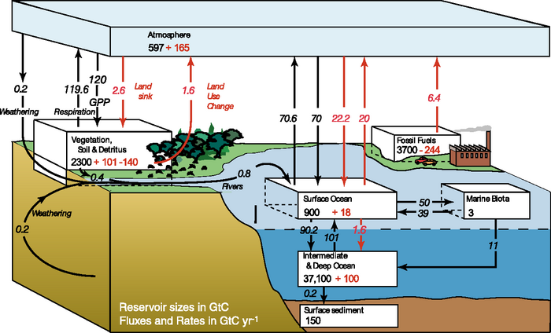
Carbon Cycle
Notes:
The figures given by the IPCC in AR4 are 4.1 +/- 0.1 GtC y-1 annual mean CO2 growth rate for the period 2000 to 2005 with annual emissions from fossil fuel burning and cement production at 7.2 +/- 0.3 GtC y-1 for that same period. The sink to the ocean carbon pool is estimated as 2.2 +/- 0.5 GtC y-1 and that to the land pool as 0.9 +/- 0.6 GtC y-1 (0.9 + 2.2 + 4.1 = 7.2).
For example, the land sink of around 0.9 +/- 0.6 GtCy-1 is itself composed of a balance between a primary production land sink and a land use change source.

Slide 8
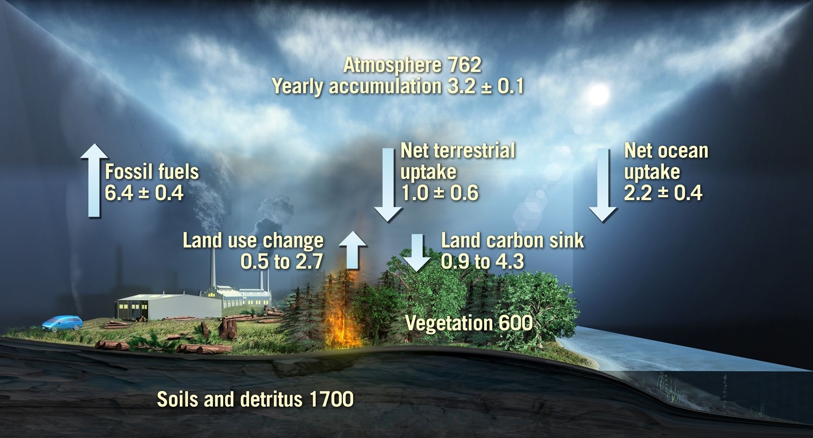
The global carbon cycle for the 1990s
Values from IPCC 2007. Units: Gigatons of carbon/ yr
Notes:
Values from IPCC 2007 – average for 90s
FF
Atmos increase
Balance made up by net flows to ocean and land
Important to note that the net flux to the land has 2 components
Anthropogenic source (LUC – not just fire)
Sink term, some of which is die to forest growth
Also shown on slide are C pools
600 Gtc in veg biomass, comparable to atmos
Soils poll, 3 times larger , but less mobile on annual to decadal t-scales
BIOMASS addresses the veg. carbon pools and fluxes associated with forests
Link: I now want to focus on the uncertainties in the fluxes

Slide 9

The mean global carbon cycle for the 1990s
9
8
7
6
5
4
3
2
1
High
Residual land sink
High
Residual land sink
Land use change flux
Land use change flux
Low
Low
Fossil fuel emissions
Net ocean
sink
GtC/year
Atmospheric increase
AnthropogenicSources
Changes in C pools
User Consultation Meeting, Lisbon, Portugal, 20-21 January 2009 biomass
Notes:
Good measurements and error estimates. Note error bars – ~20% for ocean.
Anthropogenic sources not complete – need LUC (mainly trop deforestation)
In IPCC, no error bars on this estimate, just a range, from low to high
Here’s low; for the budget to balance this implies a sink term as shown.
Here’s the high, and the corresponding sink term
If we think of the LUC range as uncertainty, it is about 70% - much greater than for the ocean flux. It dominates the error budget .
The sink term is a residual, just to make things balance. Since we have little idea of its actual magnitude, explaining it is fraught with uncertainty. Certainly uptake into biomass is part of this term
Will talk about biomass in context of 2 top boxes; the left is a decrease in biomass, part of the right is forest growth.

Slide 10
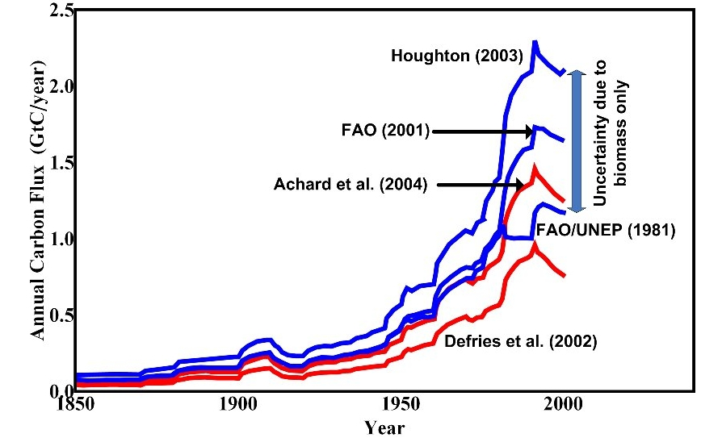
Uncertainty in carbon emissions due to biomass
Humid Tropical
Deforestation
Notes:
Uncertainty of 1 GtC pa due entirely to uncertainty in mean biomass
Also, note that these calculations take no account of the possibility that deforestaion may preferentially take areas of high or low biomass
To do this properly, we need
Maps of biomass to know what has actually been deforestsed
Scale of maps need to be comparable with the deforestation process – around 100 m
Check values of area deforested

Slide 11
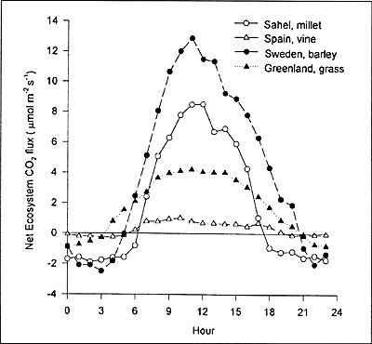
Biogeochemical processes
Net Ecosystem CO2 flux: NEP
Diurnal variations
Notes:
Explain .. Daytime flux positive, nighttime negative … GPP photosynthesis & (autotrophic) respiration

Slide 12
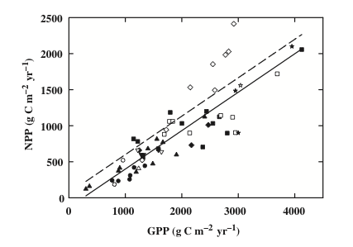
NPP/GPP: Carbon use efficiency (CUE)
Notes:
Assumed approx 0.5 but can vary significantly
CUE is C use efficiency

Slide 13
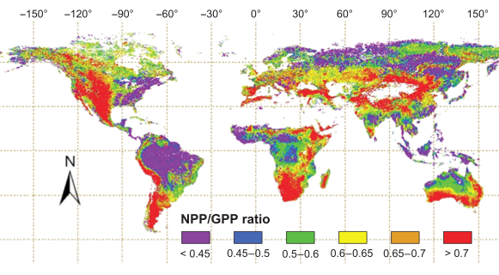
NPP/GPP
Notes:
Zhang et al GCB 2009

Slide 14
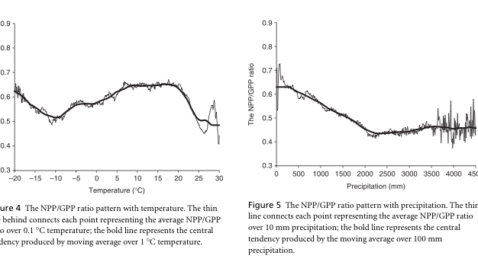
CUE dependencies
Notes:
Zhang et al. GCB 2009
Strong precip dependence, also T, altitude … discuss

Slide 15
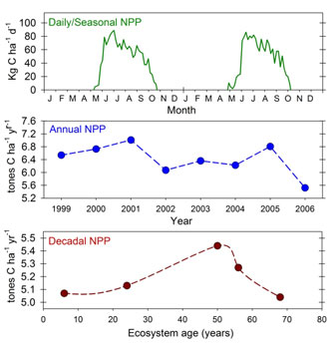
NPP temporal scales
Notes:
dicsuss

Slide 16
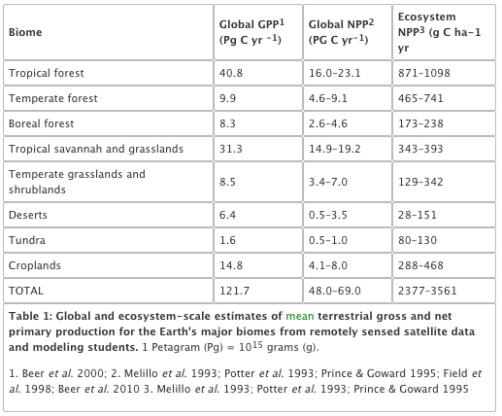
NPP biomes
Notes:
Gough, C. M. (2011) Terrestrial Primary Production: Fuel for Life. Nature Education Knowledge 2(2):1
Nice website …

Slide 17
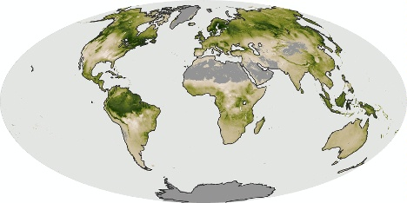
NPP: July 2006

Slide 18
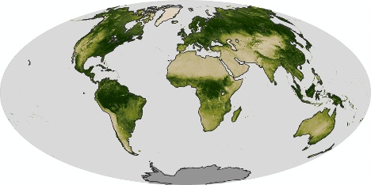
NDVI: July 2006

Slide 19
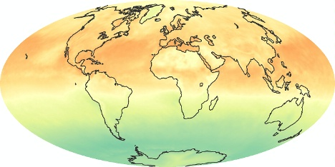
Net radiation: July 2006

Slide 20
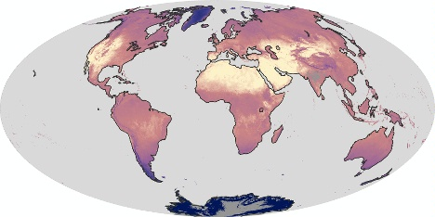
LST: July 2006

Slide 21
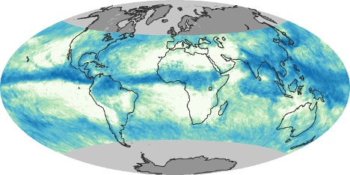
Precip: July 2006

Slide 22
NPP: July 2006

Slide 23
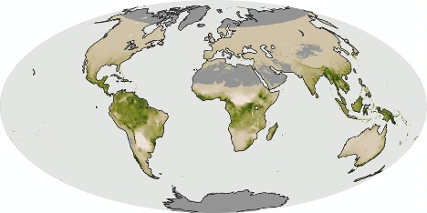
NPP: Dec 2006

Slide 24
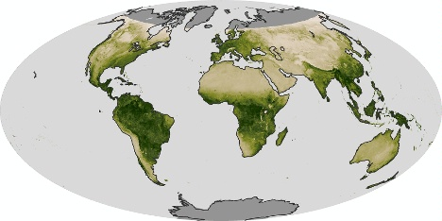
NDVI: Dec 2006

Slide 25
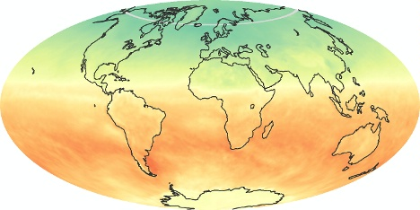
Net radiation: Dec 2006

Slide 26
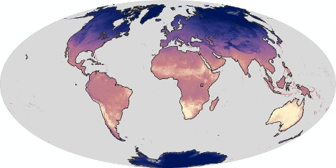
LST: Dec 2006

Slide 27
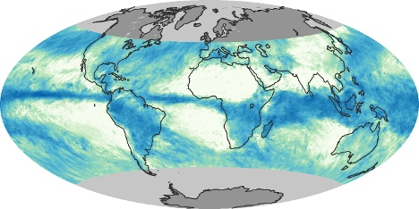
Precip: Dec 2006

Slide 28
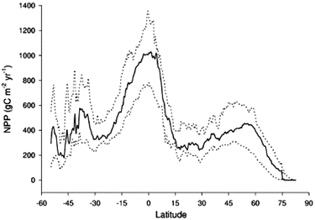
Latitudinal distribution of NPP

Slide 29
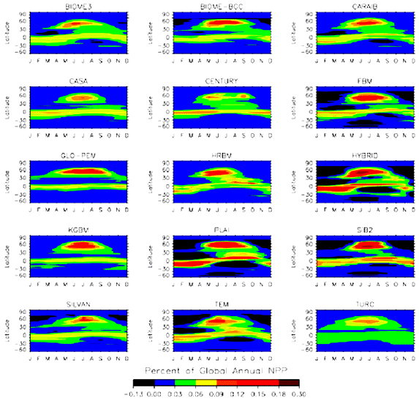
Latitudinal and time distribution NPP
Notes:
Since the total landmass (and in particular the vegetated landmass) in the Southern hemisphere is less than that of the Northern hemisphere, global NPP comes predominantly from Northern latitudes. Referring back to the plots of the annual cycle of atmospheric CO2 above, we noted a peak in May and a trough in October, largely then in response to global NPP increases in Spring and decreases in Autumn: the larger NPP in Northern hemisphere summer gradually decreases the atmospheric CO2 concentration. This is however complicated by the timing and spatial distribution of other CO2 sources and sinks.

Slide 30
Net Ecosystem Productivity
NEP = NPP minus other losses
respiration by heterotrophs (organisms – fungi, animals and bacteria in the soil),
other losses to the ecosystem such as through fire, insects, herbivory, and of course humans
QUESTION: What is the total fraction of global NPP appropriated by humans?

Slide 31
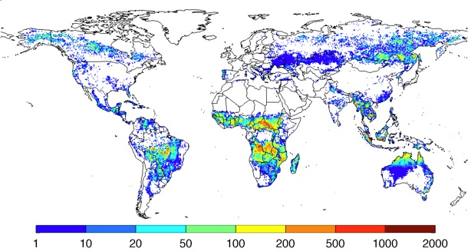
Fire: emissions g C m⁻² yr⁻¹
1997-2009
Notes:
Annual carbon emissions (as g C m-2 year-1), averaged over 1997-2009. These emissions estimates are build combining burned area data from above with a biogeochemical model (CASA-GFED) that estimates fuel loads and combustion completeness for each monthly time step. These fuel loads are based on satellite derived information on vegetation characteristics and productivity to estimate carbon input, and carbon outputs through heterotrophic respiration, herbivory, and fires

Slide 32
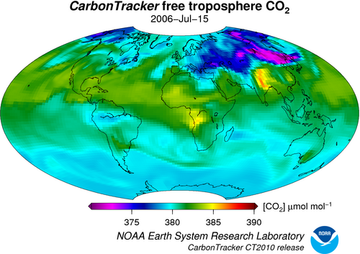
Atmos CO2
Notes:
Quite small range really (well-mixed) + rather different to NPP distributions … discuss??

Slide 33
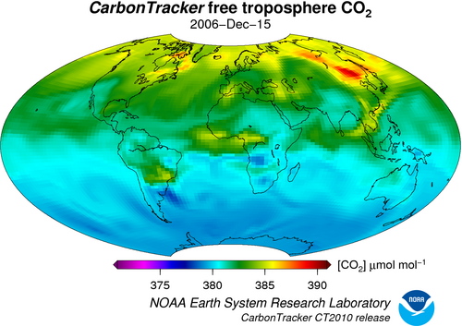
Atmos CO2

Slide 34
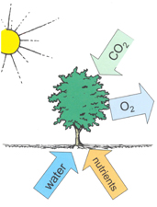
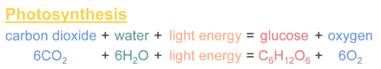
Photosynthesis
Notes:
In essence, what it does is to split (proportionately) 12 water molecules (H20) and produce 6 molecules of oxygen gas (O2) and 6 of H20. Carbon dioxide is reduced to glucose (C6H12O6) which is the basic material from which other biochemical constituents of biomass are synthesised (Grace, 2001). Note that the additional 6H2O are omitted in the figure above which does not include transpiration.

Slide 35
Transpiration
Provides 10% of moisture found in atmosphere.
uses around 90% of water that enters plant
(the rest being used in cell growth and photosynthesis).
Most transpiration water in stomata of the leaves.
guard cells of the stomata open to allow CO2 diffusion from the air for photosynthesis.
can be thought of as the “cost” for opening stomata to allow the diffusion of carbon dioxide gas from the air.

Slide 36
Stomatal conductance
Stomatal conductance, (e.g. in mmol m⁻² s⁻²)
measure of the rate of passage of carbon dioxide (CO2) exiting, or water vapor entering through the stomata of a leaf.
controlled by guard cells leaf stomata and controls transpiration rates and CO2 diffusion rates (along with gradients of water vapour and CO2).

Slide 37
Transpiration serves three main roles:
movement of minerals
(from roots: xylem) and sugars (from photosynthesis: phloem) throughout the plant.
cooling
(loss of heat energy through transpiration)
maintenance of turgor pressure
in plant cells for plant structure and the functioning of guard cells in the stomata to regulate water loss and CO2 uptake.

Slide 38
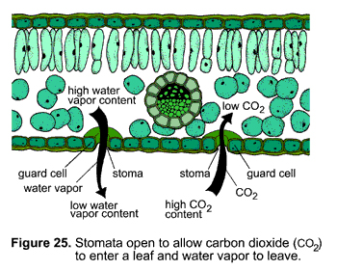
stomata

Slide 39
three types of photosynthesis mechanisms
C3, C4, CAM (Crassulacean acid metabolism)
C3 (much older, but less efficient)
85% of plants
wheat, barley, potatoes and sugar beet and most trees.
cannot grow in hot climates because RuBisCO incorporates more oxygen into RuBP as temperatures increase
photorespiration and a net loss of carbon (and nitrogen) that can act as a limit to growth.
C3 plants are also sensitive to water availability.
Notes:
Rubisco Ribulose-1,5-bisphosphate carboxylase/oxygenase

Slide 40
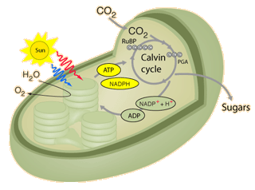
C3 plants use the Calvin cycle for fixing CO2.
Notes:
In the first step of the cycle CO2 reacts with RuBP to produce two 3-carbon molecules of 3-phosphoglyceric acid (3-PGA). This is the origin of the designation C3 or C3 in the literature for the cycle and for the plants that use this cycle. The entire process, from light energy capture to sugar production occurs within the chloroplast. The light energy is captured by the non-cyclic electron transport process which uses the thylakoid membranes for the required electron transport.

Slide 41
C4 Plants
C4 plants (and CAM plants)
more efficient than C3 plants under conditions of drought, high temperatures, and nitrogen or CO2 limitation.
bypassing the photorespiration pathway and efficiently delivering CO2 to the RuBisCO enzyme

Slide 42
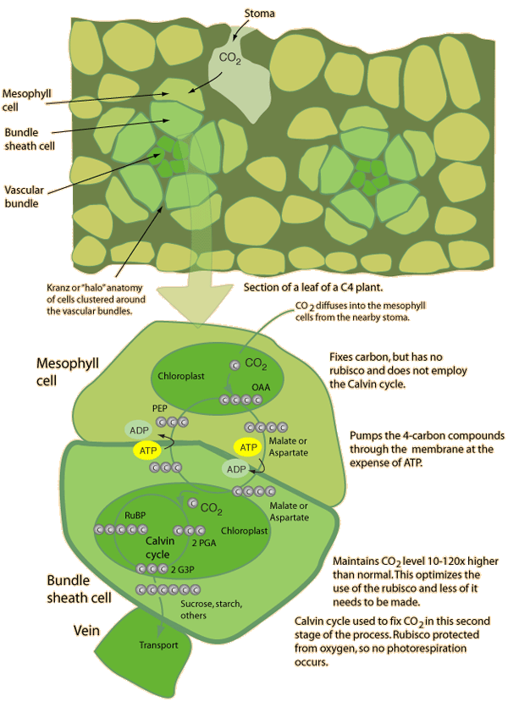
C4
Notes:
Different structure

Slide 43
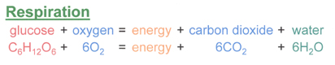
Respiration
(autotrophic) respiration
plants convert sugars back into CO2 and water, and release energy in the process.
energy released used for growth and maintenance of existing material.
Consumes 25% to75% of all of the carbohydrates generated in photosynthesis.

Slide 44
Limitations to photosynthesis at the leaf level
light limitation;
CO2 limitation;
nitrogen limitation and photosynthetic capacity;
water limitation;
temperature effects;
pollutants

Slide 45
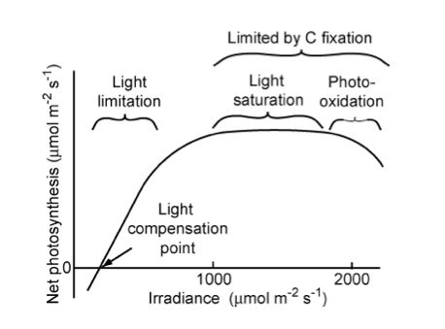
light limitation
Notes:
"Relationship of net photosynthetic rate to photosynthetically active radiation and the processes that limit photosynthesis at different irradiances. The linear increase in photosynthesis in response to increased light (in the range of light limitation) indicates relatively constant light use efficiency. The light compensation point is the minimum irradiance at which the leaf shows a net gain of carbon. " Source: Chapin, 2011, PTEEChap5.ppt, fig. 5.5

Slide 46
Light limitation
rate of change of net photosynthesis in low-moderate region: quantum yield of photosynthesis.
Similar for all C3 (non stress) at ~6%
Saturation at higher levels: reduced efficiency
Acclimation responses
Sun leaves
More cell layers and higher photosynthetic capacity
Respiration rate depends on tissue protein content
So shade leaves lower protein content to minimise respiration losses

Slide 47
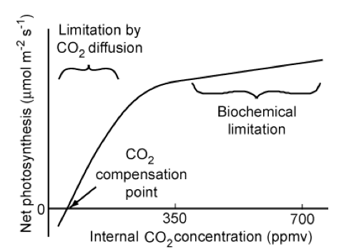
CO2 limitation
C3
Notes:
"Relationship of the net photosynthetic rate to the CO2 concentration inside the leaf. Photosynthetic rate is limited by the rate of CO2 diffusion into the chloroplast in the initial (left-hand side) linear portion of the CO2 response curve and by biochemical processes at higher CO2 concentrations. The CO2 compensation point is the minimum CO2 concentration at which the leaf shows a net gain of carbon. " Source: Chapin, 2011, PTEEChap5.ppt, fig. 5.10

Slide 48
CO2 limitation
Over long term, indirect effects of elevated CO2 concentrations may be more important than increased net photosynthesis rates
E.g. changes to water cycle
C4 relatively unresponsive
Less competitive in higher CO2 environment?
Probably indirect effects important

Slide 49
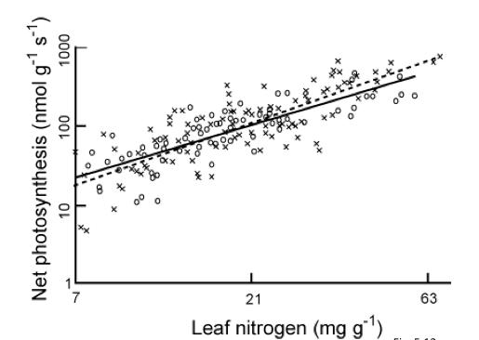
Nitrogen limitation and photosynthetic capacity
Reich et al 1997: 11 species, 6 biomes
Notes:
"Relationship between leaf nitrogen concentration and maximum photosynthetic capacity (photosynthetic rate measured under favorable conditions) for plants from Earth's major biomes. Circles and the solid regression line are for 11 species from six biomes using a common methodology. Crosses and the dashed regression line are data from the literature. Redrawn from Reich et al. (1997)." Source: Chapin, 2011, PTEEChap5.ppt, fig. 5.11

Slide 50
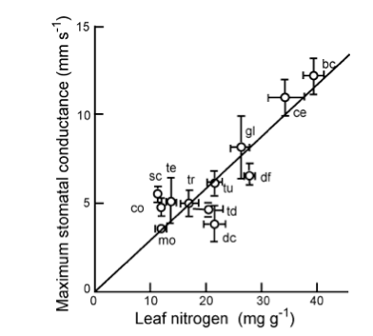
Nitrogen
bc: Broadleaf crops
ce: cereal crops
co: evergreen conifer
dc: deciduous conifer
df: tropical dry forest
gl: grassland
mo: monsoonal forest
sc: sclerophyllous shrub
sd; dry savanna
sw: wet savanna
tc: tropical tree crop
td: temeperate decid broadleaf
te: temp everg broadleaf
tr: tropical wet forest
tu: tundra
Notes:
"Relationship between leaf nitrogen concentration and maximum stomatal conductance of plants from Earth's major biomes. Each point and its standard error represent a different biome: bc, broad-leafed crops; ce, cereal crops; co, evergreen conifer forest; dc, deciduous conifer forest; df, tropical dry forest; gl, grassland; mo, monsoonal forest; sc, sclerophyllous shrub; sd, dry savanna; sw, wet savanna; tc, tropical tree crop; td, temperate deciduous broadleaved forest; te, temperate evergreen broadleaved forest; tr, tropical wet forest; tu, herbaceous tundra. Redrawn from Schulze et al. (1994)." Source: Chapin, 2011, PTEEChap5.ppt, fig. 5.12

Slide 51
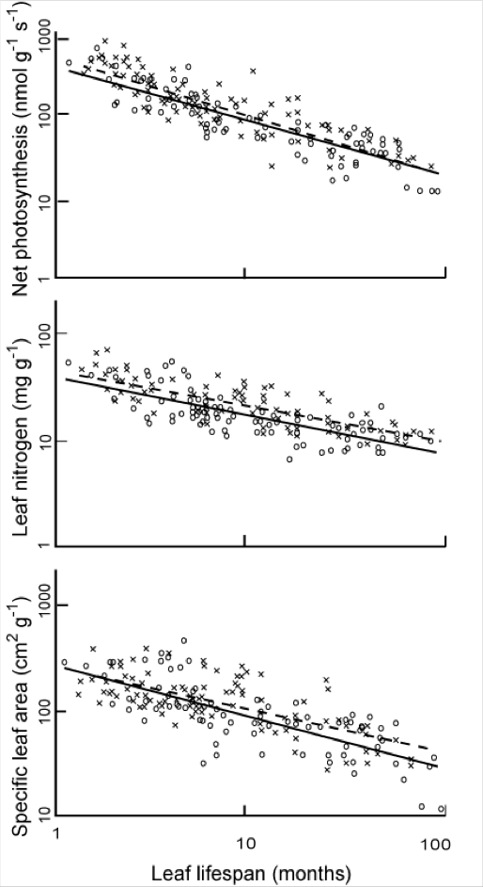
Nitrogen
Relationships between N, leaf lifespan, SLA and net photosynthesis
higher the leaf N concentration, the shorter the leaf lifespan.
Leaves with shorter lifespans tend to have lower specific leaf area (SLA, the leaf surface area per unit of biomass) (i.e. long-lived leaves are more dense), so higher leaf N concentration correlates with higher SLA.
Notes:
"The effect of leaf lifespan on photosynthetic capacity, leaf nitrogen concentration, and specific leaf area. Symbols as in Fig. 5.13. Redrawn from Reich et al. (1997)" Source: Chapin, 2011, PTEEChap5.ppt, fig. 5.13

Slide 52
Water limitation
reduces the capacity of leaves to match CO2 supply with light availability
manifested as a decrease in leaf relative water content (RWC).
Decreasing RWC progressively decreases stomatal conductance which slows CO2 assimilation (lower photosynthetic capacity) although different studies show different responses for RWC between 100% and 70%

Slide 53
Water limitation
Plants acclimated and adapted to dry conditions
reduce photosynthetic capacity and leaf N concentrations
low stomatal conductance that conserves water
minimse leaf area (shedding or lower leaf production rates) to minimise water loss.
Some minimise radiation absorption by higher leaf reflectance more vertically-inclined (erectophile) leaves.

Slide 54
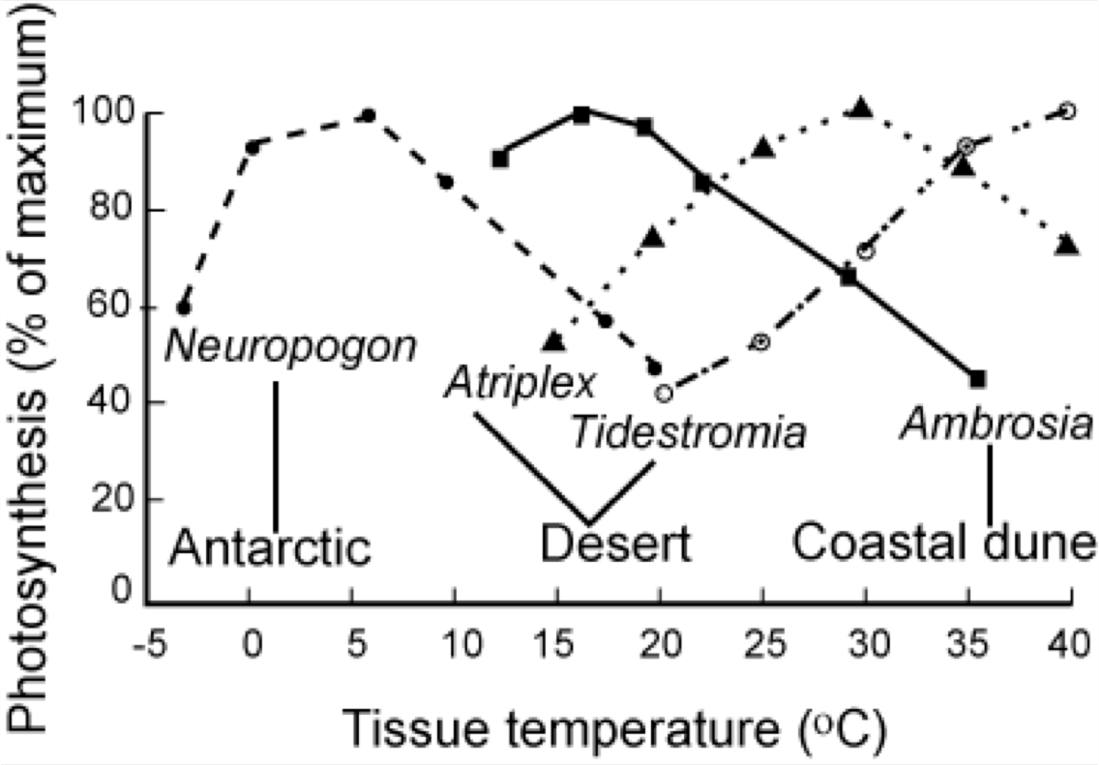
Temperature effects
Notes:
Adaptation for different species, but all have optimal operating range

Slide 55
summary
looked in detail at the terrestrial carbon cycle
provided an overview of relevant biogeochemical processes

